Slide 1
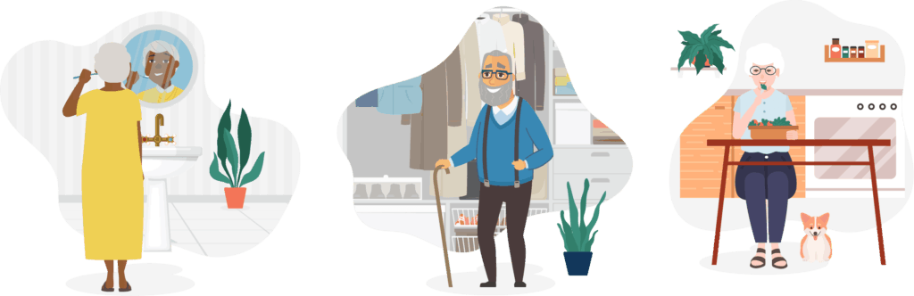
Kinetics and Kinematics of Activities of Daily Living
Dr. Preeti Ganachari
Dept. Of Neurophysiotherapy
Mgm Institute Of Physiotherapy
Chh. Sambhajinagar

Slide 2
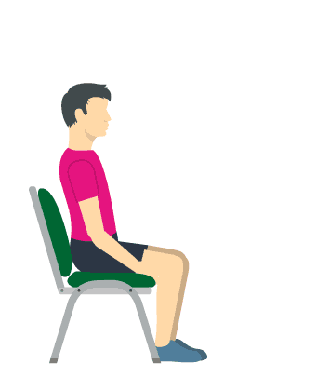
Content
What is Kinetic and Kinematics
Supine to sitting
Sitting to Standing
Squatting
Climbing up and Down
Lifting, Pulling, Pushing , Overhead Activities
Running, Jogging

Slide 3
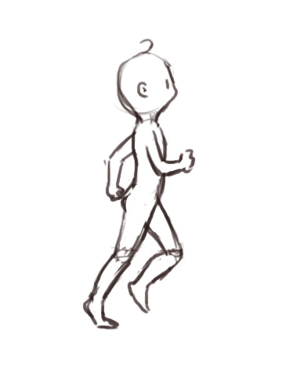
Biomechanics is a study of human movement.
It applies the law of mechanics and physics to human performance and aims to explain how and why the human body moves as it does by analyzing the forces acting on the body(kinetics) and the movement of the body(kinematics) .
It is used specially in sports and exercises, with two main purposes:
1. To improve physical performance
2. To prevent injuries
Besides human movements in sports and exercise, biomechanics can also be used in ADLs.
It is provided to guide you in thinking through kinematic analysis.

Slide 4

Each of this skill analyses will break down the activity into 3 components.
The first element identifies the SEQUENCE OF ACTIVITIES
The second element descripts of the JOINT MOVEMENTS throughout the activity
The third and final element distinguishes about the MUSCLES and how they produce joint movement.
MOBILITY
Mobility is important in the ability to move from one position to another and to move the body into positions that permit desired functions.
Mobility is basic to function.

Slide 5
What is Kinetic and Kinematics
Kinetic- Deals with forces that produce, stop or modify motion of either the body as a whole or the individual body segments.
Kinematics- Deals with the motion of the body and/or its segments without regard to the forces acting to produce those motions .

Slide 6
Supine to sitting
Kinematics – Sequence of Movement
The rolling sequence to the right starts with the left upper extremity reaching across the body with movement initiated by the humerus and scapula and is immediately followed by the left elbow, wrist, and hand motions.
Arm movement is followed by head motion, rotating to the right to look in the direction of motion. Head motion is immediately followed by trunk rotation to the right side. As the trunk rotates, the left hip begins its motion.
Just before the body weight moves over the right upper extremity, this limb tucks next to the body to allow the body’s rolling to continue unimpeded.
Once full rotation to the prone position occurs, body weight rolls towards the left arm as the right upper extremity moves from beneath the body to align into a comfortable position

Slide 7
Supine to sitting
Kinematics – Joint Motion
Left arm leads by scapular protraction and shoulder flexion and horizontal adduction to move the arm across the anterior trunk.
Left elbow – extension
Forearm pronates with the wrist in neutral,
Fingers and thumb extend and abduct to extend the arm’s reach across the body.
Right arm moves out of the way of the body roll so the arm is positioned next to the side right shoulder extends next to the side with scapular retraction

Slide 8
Supine to sitting
Kinematics – Joint Motion
Head turns to the right , the neck rotates and laterally flexes to the right and the trunk flexes slightly and rotates to the right
Neck and trunk continue to move in flexion , rotation and lateral flexion.
The left side of the pelvis rotates forward, the left hip flexes and adducts, the knee flexes, and the ankle and foot is either held in neutral or assists by pushing off the floor in neutral or in slight Plantar flexion

Slide 9
Supine to sitting
Kinetics –Muscle Activity
Left scapula protraction – Serratus anterior, Upper & Lower Trapezius,
Shoulder flexion- Anterior deltoid, Clavicular portion of pectoralis major and coracobrachialis.
Humeral horizontal adduction – concentric contraction of anterior deltoid and Pectoralis major until arm passes the body’s midline, at which time the posterior deltoid controls the horizontally adducting shoulder by exerting an eccentric contraction against gravity.

Slide 10
Supine to sitting
Kinetics –Muscle Activity
Elbow extension- Triceps
Forearm pronation- combined efforts of pronator qudratus and pronator teres
Wrist extension- Extensor carpi radialis longus and brevis and ECU
Finger extension- Extensor digitorum and abducted by the introssei the thumb extension by – extensor pollicis.
Right side neck flexion and lateral rotation- sternnocledomastiod right scalene

Slide 11
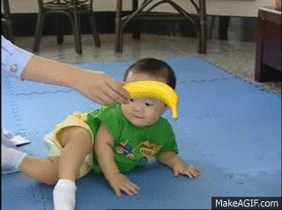
Supine to sitting
Kinetics –Muscle Activity
Trunk flexion and by rectus abdominus and right side rotation by right internal abdominal oblique and left external abdominal oblique
Once the body weight shifted beyond side lying in preparation to accept body weight, the left shoulder flexes powered by the anterior deltoid , clavicular porion of pectoralis major and corachobrachialis

Slide 12
Floor -to- stand
Kinematics – Sequence of movements
Head and trunk erect
Knee extends in front and hip stay flexed as the individual assume long sitting position.
Weight shifted to right hip the right arm supports part of the trunk weight with the hand on the floor as both sets of knees and hips flex with left leg on top of the right leg in a side sitting position.
Trunk and pelvis rotation it further rotates to move both arms into weight bearing position and knees are moved underneath the body to move in quadruped.
Hip- Extension to kneeling ---to weight bearing on right knee to place left foot flat on floor

Slide 13
FLOOR -TO- STAND

Slide 14
FLOOR -TO- STAND
Kinematics – Joint motion
Head and trunk are aligned with each other neutral
Lower limb – hip flexed 90 degree knee extended in along sitting position
Weight shift over right buttock as the right arm is placed in extension medial rotation and some abduction at the right side.
Right elbow, wrist fingers and thumbs are all extended to allow weight bearing
Neck and trunk rotates and laterally flex to the right.
Hip flexion little more and knee flex to move body in side sitting

Slide 15
FLOOR -TO- STAND
Kinematics – Joint motion
From side sitting Trunk rotates over the lower limb and body shifts into quadruped with hips , shoulders and knees flexed at 90 degree, the scapula and pelvis stabilized and the elbow, wrist, fingers and thumbs all extended.
From Quadruped hip extends with back straight to move trunk into upright kneeling
The neck and Trunk midline
Left hip abducted, flex and laterally rotates left knee flexes as the ankle dorsiflexes to move the limb and place the foot on the floor in front of body with knee and hip flexed to or beyond 90 degrees

Slide 16
FLOOR -TO- STAND
Kinematics – Joint motion
from this position the individual flexes the hips to move the trunk over the left knee.
As the center of mass moves forward and over the left lower extremity, the left hip and knee extend to lift the body upward and the right hip and knee extend as the body moves to a standing position

Slide 17
FLOOR -TO- STAND
Kinetics- Muscle Activity
Neck flexors and extensors- SCM, Scalene and Spleius capitus and cervicus
In Conjunction with Erector Spinae and abdominals at the trunk co contraction to maintain stability of the head and trunk when long sitting
Side sitting the right scapula retracts and depress through eccentric contraction of Rhomboids and middle and lower Trapezius.
Muscle producing Humeral extension, abduction and medial rotation includes Lattissimus dorsi, teres major, and infraspinatus

Slide 18
FLOOR -TO- STAND
Kinetics- Muscle Activity
The elbow is extended via triceps and wrist, thumb and fingers extend through ECU,ECRL,ECRB, ED,EPL.
Hip flexion – illiopsoas, recuts femoris, and pectineus.
Knee flexion by hamstrings
Left hip gluteal muscles continues to work eccentrically to lower the thigh into adduction against gravity
Side sitting to quadruped- right side trunk rotation by left external and right internal oblique.

Slide 19
FLOOR -TO- STAND
Kinetics- Muscle activity
From Qudruped to kneeling
Quadruped to kneeling- hip 90 degree of flexion to increased flexion via concentric contraction of hamstrings and eccentric contraction gluteal contractions.
The erector spine and abdominals muscle contract isometrically to maintain a straight spine during the hip and knee flexion

Slide 20
FLOOR -TO- STAND
Kinetics- Muscle activity
From Upright kneeling to half kneeling
Right gluteus maximus maintains right hip extension
The pelvic stabilisers on right and left side gluteus medius and minimus , abdominals and erector spinae all fore to support the body’s weight shift to the right knee as the left thigh abducts and trunk laterally flexes to move centre of mass over the right limb.
Left knee unweighted, the left hip abducts through the action of gluteus medius and minimus and TFL. And Sartorius.

Slide 21
FLOOR -TO- STAND
Kinetics- Muscle activity
From half kneeling to standing
Erector spiane eccentrically control a straight spine during forward motion of the trunk as the center of mass is shifted forward over the left hip and knee.
The Gluteus maximus and hamstrings are engaged eccentrically on the left to control the amount and speed of this forward shift over a hip flexing to about 70 degree as the right knee becomes unweighted
The left ankle maintin its positon by eccentric contraction gastrocnemius as the tibia advances over the foot and COM moves anterior to the ankle.

Slide 22
FLOOR -TO- STAND
Kinetics- Muscle activity
From half kneeling to standing
Left leg is stabilized in this forward position, the right hip extends through the action of the gluteus maximus and hamstrings,
The knee is extended by the qudricpes , and the right foot pushes off the floor from planterflexed ankle propelled by the force of gastrocnemius.
As the foot pushes off the floor the left knee simultaneously extends via concentric contraction of quadriceps and left hip extends through G max. and foot is stabilized by gastrocnemius and Posterior calf muscles.

Slide 23
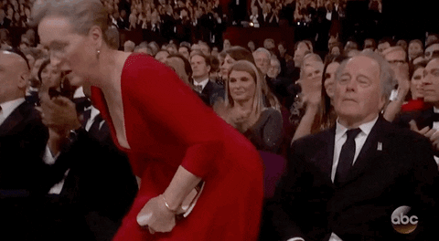

Slide 24
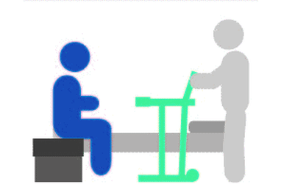
TRANSFER
A transfer refers to movement from one surface or position to another and may be accomplished independently or with assistance.

Slide 25
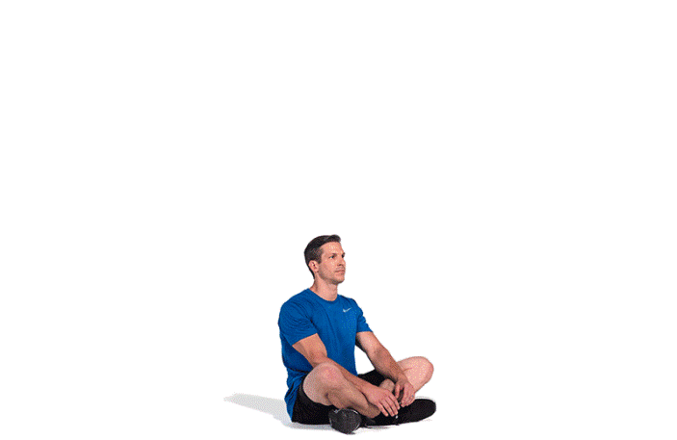
SIT TO STAND
Kinematics – Sequence of Movement
The hips move to the edge of the seat and the body leans forward to place the trunk’s center of mass over the legs.
The hands are on the arms of the chair. As force is directed down on the hands, the center of mass moves forward over the feet as the lower limbs simultaneously extend.
As the lower extremities reach their end extension position, the trunk moves upright to place the body’s center of mass over the feet, and the hands move to rest by the lateral thighs

Slide 26
SIT TO STAND
Kinematics – Joint motion
The hips are moved forward in the chair either by “walking the hips forward” or by pushing the back against the back of the chair.
In walking the hips forward, the body weight moves from one side of the pelvis to the other as the non weight-bearing pelvis rotates forward until the hips are on the edge of the seat.
If the individual moves forward by pushing against the back of the chair, the back extends into the chair to allow the hips to slide forward, then the trunk moves to an upright position when the hips are at the edge of the seat.

Slide 27
SIT TO STAND
Kinematics – Joint motion
The hands are placed in the arms of the chair with the elbows flexed to about 90 degree, the shoulders are hyperextended with the elbows behind the trunk, and the hips are flexed to position the trunk forward over the thighs.
Knees are flexed beyond 90 degree to move the feet under the hips, and the ankle are dorsi flexed.
Back straight forarm position depends on how the arms of the chair are grasped may be in pronation or neutral mid position
The wrists are in extension and the fingers and thumbs are flexed, grasping the arms of the chair.

Slide 28
SIT TO STAND
Kinematics – Joint motion
Standing begins the shoulders move from hyperextension to either slight hyperextension or neutral extension,
The elbows extends, the wrist move towards neutral hand come of the chair arms.
Neck moves from hyperextension to align with trunk in neutral as the hips and knees extend.
Before hip extension to move upright , the head must move ahead of the feet so the center of mass is positioned over the feet.

Slide 29
SIT TO STAND
Kinetics- Muscle activity
Tibialis anterior muscle—activated for preparatory placement of foot backward and tibial stabilization.
Simultaneous onset of activity in the hip extensors (gluteus maximus and biceps hamstrings) and knee extensors (rectus femoris, vastus lateralis and medialis muscles).
Activity of these extensors peaks when the thighs are lifted off the seat, and to varying degrees, the gastrocnemius and soleus muscles play a role in postural control

Slide 30
SIT TO STAND
Kinetics- Muscle activity
Although moving through sit-to-stand and then returning to sitting from standing appear to be fundamentally the same task in reverse, these two tasks have different muscular demands.
The joint excursions at the hip, knee, and ankle are similar, but in retuning to a seated position, the muscles of the lower extremities act eccentrically.
The same muscles activate in the sit-to-stand, but act concentrically. There is some evidence that the trunk is of less importance in this aspect of the transfer task, whereas the greatest demands occur at the knee

Slide 31
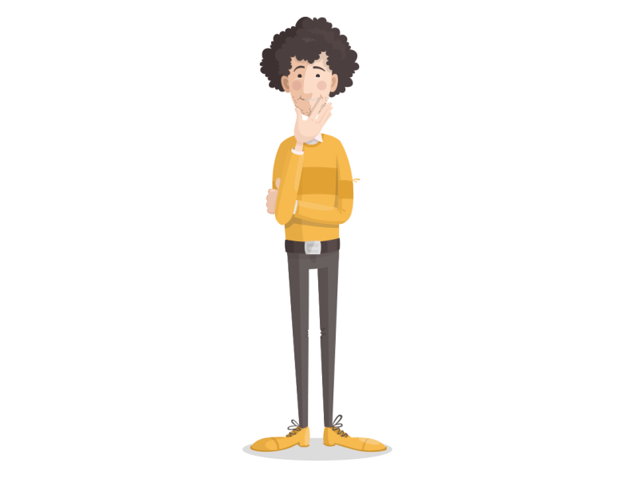

Slide 32
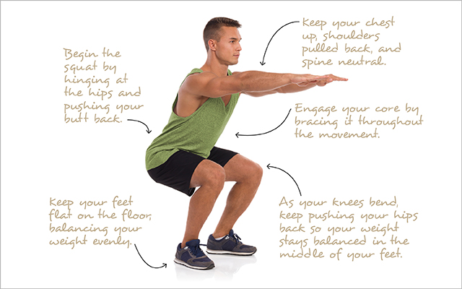
SQUATTING
Kinematics- Sequence of event
Foot- stabilized on the ground. During the initial phase of the movement, the centre of pressure (COP) is shifted towards the heel and next, during the second phase of the movement, which is braking, COP is shifted towards the toes.
Ankle-dorsiflexion / plantarflexion, eversion/inversion, as well as a small amount of abduction and adduction.
Knee - carries out sagittal plane movement throughout a range of motion of 0 to approximately 160 degree of flexion A small amount of axial rotation is also present at the joint during dynamic movement, with the femur rotating laterally during flexion and medially during extension with respect to the tibia.

Slide 33
SQUATTING
Kinematics- Sequence of event
Patellofemoral joint- a gliding joint in which the patella slides over the trochlear surfaces of the femur during flexion and extension of the knee
ACL- prevents anterior tibial translation at the knee, particularly at low flexion angles. It also plays a role in limiting internal and external rotation of the knee and inhibiting varus/valgus motion.
Hip joint- During the squat, hip torques increase in conjunction with increases in hip flexion, with maximal torque occurring near the bottom phase of movement

Slide 34
SQUATTING
Kinetics- Muscle activity
At the beginning of the movement, the quadriceps muscle does not exhibit any electrical activity. The movement is initiated by the anterior tibialis muscle. Inhibition of ankle joint muscles can contribute to the shift of COP
The Gastrocnemius- medial head acts as a dynamic knee stabilizer during squatting helping to offset knee valgus moments as well as limiting posterior tibial translation The gastrocnemius shows only moderate levels of activation during squatting, with activity tending to progressively increase as the knees flex and decrease as the knees extend

Slide 35
SQUATTING
Kinetics- Muscle activity
The hamstrings (biceps femoris, semitendinosus, semimembranosus) are technically antagonists of the quadriceps, opposing knee extensor moments. In closed-chain exercise, however, they behave paradoxically and co contract with the quadriceps.
The primary hip muscles involved during the squat are the gluteus maximus (GM) and the hamstrings. The GM is a powerful hip extensor, acting eccentrically to control squat descent and concentrically to overcome external resistance on the ascent.

Slide 36
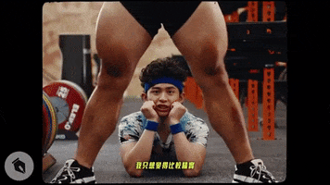
SQUATTING
Kinetics- Muscle activity
The iliotibial band, the GM is also thought to play a role in stabilizing knee and pelvis during squatting

Slide 37
LIFTING
One of the main elements of a safe lifting task is the importance of proper body mechanics.
Proper body mechanics will ensure that the back is well protected and that the motions required at the contributing body segments are not only effective, but efficient.

Slide 38
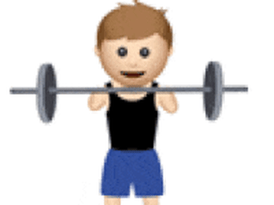
LIFTING
Kinematics – Sequence Of Movement
The movement begins with an active postural “set” by the head, trunk, and pelvis.
The individual holds his or her head and trunk in their midline alignment and stabilizes the lumbar spine by moving the pelvis into its neutral position.
At no time during the activity should the individual flex the spine; it should remain in its properly aligned position, using the hips to move the torso rather than the back. Prior to lifting, the individual tests the object to be lifted to get an idea of its weight

Slide 39
LIFTING
Kinematics – Sequence Of Movement
The individual then establishes a wide base of support standing close to the object as he or she prepares to lift it.
To move into a squat, the hips laterally rotate to about 45° and flex to about to 90°.
The ankles move into dorsiflexion as the tibia moves forward over the foot, and the knees flex to lower the body so the hands are able to grasp the box.

Slide 40
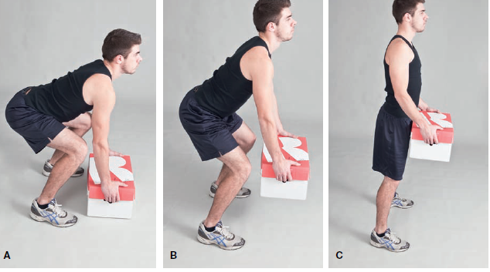
Lifting
Kinematics – Sequence Of Movement
The hip position of abduction and lateral rotation is maintained throughout the preparation phase. As the squat brings the individual’s hands closer to the box, the hips flex to move the torso over the box, keeping the back straight and in its neutral position.
As the squat lowers the individual close to the box, the upper extremities move forward into shoulder flexion with extended elbows to reach and obtain a firm grasp of the object.

Slide 41
To begin to lift the box, the hands obtain a secure grasp on it in finger flexion with the shoulder girdle , elbow and wrist muscles ‘set’ to accept the weight .
The box is then moved closer to the body with ; with the trunk erect , the individual moves to stand up.
Once the box is secured, the standing motion is accomplished from the power in the lower extremities.
The standing motion is initiated by hips and knees.
As the individual stands, the box remains close to the body, the trunk maintains its neutral position, and the feet maintain a wide base of support.

Slide 42
LIFTING
Kinematics – Joint motion
To begin to lift the box, the scapular rotators (upward and downward) cocontract to stabilize the scapula as the shoulders move to about 60° of flexion, adducted near the trunk with the shoulders midway between medial and lateral rotation.
The elbows and forearms are in extension and midposition to reach for the box and grasp it.
The wrists extend into functional position and the thumb and fingers move first into full extension and abduction to reach the box and then into flexion and adduction to grasp it.

Slide 43
LIFTING
Kinematics – Joint motion
The shoulders are adducted and the scapula is stabilized against the thorax.
Once the box is secured and moved closer to the trunk, the hips and knees move into extension, maintaining a wide base of support with the hips in some abduction and lateral rotation

Slide 44
LIFTING
Kinetics- Muscle activity
Neck flexors (SCM and scalene) and extensors (splenii). The erector spinae and abdominals contract to stabilize the trunk.
The pelvis and lumbar spine maintain their neutral position By co-contraction of the transverse abdominus and multifidus muscles.
The wide base of support in hip abduction is accomplished by contractions of the gluteus medius and minimus,TFL, and the sartorius.
The hips are laterally rotated by the gluteus maximus and deep lateral rotators, with contributions from the sartorius.

Slide 45
LIFTING
Kinetics – Muscle activity
Moving into a squat, the erector spinae muscles isometrically contract to maintain proper spinal position and the abdominals provide lumbar stabilization.
The hips and knees flex using eccentric contractions of the gluteus maximus and hamstrings at the hip and quadriceps at the knee.
As the squat deepens, the deep lateral rotators, gluteus maximus, and sartorius continue to maintain the hips in lateral rotation.

Slide 46
LIFTING
Kinetics – Muscle activity
The gastrocnemius soleus muscles stabilize the ankles in this closed chain position on the floor. Additionally, the gastrocnemius fires eccentrically to control the tibia moving forward over the foot into dorsiflexion.
As the squat bring the individual closer to the box , the hip extensors eccentrically control the required amount of trunk motion forward to reach towards the box, during this part of preparation phase, the erector spinae maintains the position.
The UEs will now be engaged for lifting task.

Slide 47
As the box is lifted,
1. the shoulders move into flexion by the clavicular portion of pectoralis major, anterior deltoid, and coracobrachialis,
and are adducted alongside the trunk by the pectoralis major, latissimus dorsi, and teres major,
midway between medial and lateral rotation by the subscapularis, anterior deltoid, infraspinatus, and teres minor muscles.
2. Since the shoulders are not elevated much during motions, the scapulae maintain their positions with cocontraction of upward and downward rotation to provide a stable base for humeral head.
3. The elbows are maintained in extension by cocontraction of triceps and elbow flexors.

Slide 48
4. The wrist stabilized by cocontraction of wrist extensors and finger flexors.
5. Fingers adducted by palmar interossei.
6. Thumb adducted and flexed by flexor policis and adductor policis.
Once the box is firmly secured, all these muscles maintain and isometric contraction to grasp and hold the box in place.
7. When individual id ready to lift, the knees and hip extend through contraction of gluteus maximus and hamstring at hip and quadriceps at knee.
8. The BOS stays wide in hip abduction and LR; provided by glu medius, glu minimus, g max, sartorius, deep lat rotators to stand upholding the box.

Slide 50
CLIMBING UP AND DOWN
Kinematics –The stance phase during stair Ascent is subdivided into three specific sub-phases:
1)Weight acceptance (WA: the initial movement of the body into an optimal position to be pulled up);
2) Pull up (PU: the main progression of ascending from one step to the subsequent step);
3)Forward continuance

Slide 51
CLIMBING UP AND DOWN
The swing phase ASCENT is subdivided into two specific sub phases:
Foot clearance (FCL: the bringing of the leg up and over to the next step while keeping the foot clear of the intermediate step); and
2) Foot placement (FP: simultaneous lifting of the swing leg and leg positioning for foot placement on step)

Slide 52
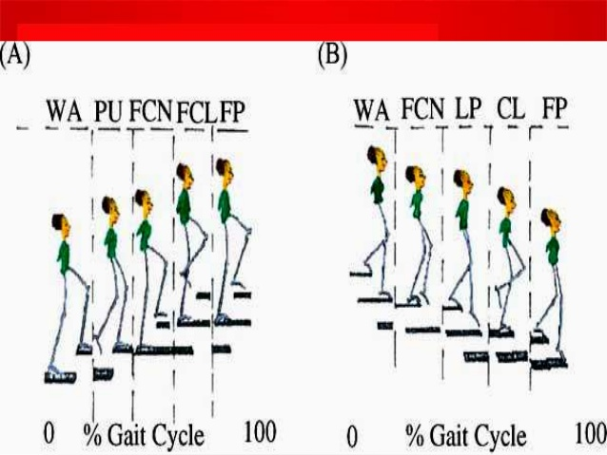
CLIMBING UP AND DOWN
The stance phase of descent is divided into three specific sub phases:
Weight acceptance (WA);
Forward continuance (FC: the commencement of single leg support and the body begins to move forward);
Controlled lowering (CL: the major portion of progression when descending from one step to the next)

Slide 53
Ascending Stairs
Kinematics – weight acceptance through forward continuance
Hip- 30 degree flexion
Knee – 30 degree of flexion
Ankle- 20 dorsiflexion
Kinematics- pull up through forward Continuance
Hip- Extension 30 – 5 degree
Knee- Extension 30-10 Degree of flexion
Ankle – Planter flexion 15 degree

Slide 54
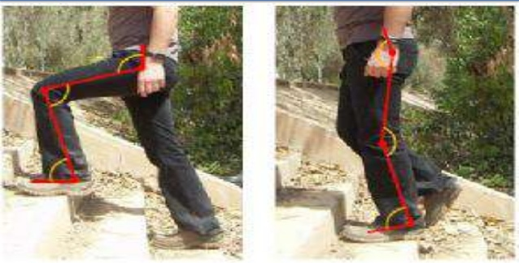
Ascending Stairs
Kinetics- muscle activity
Hip – Gluteus Maximus,
Semitendinos
Gluteus Medius
Knee- Vastus lateralis
Rectus Femoris
Ankle- Tibialis anterior
Soleus
gastrocnemius

Slide 55
Ascending stairs
Pull up through forward continuance
Kinetics- muscle activity
Hip – G maximus , Gluteus Medius, Semitendinosus
Knee- Vastus Lateralis
Rectus Femoris
Ankle- Soleus
Gastrocnemius
Tibialis anterior

Slide 56
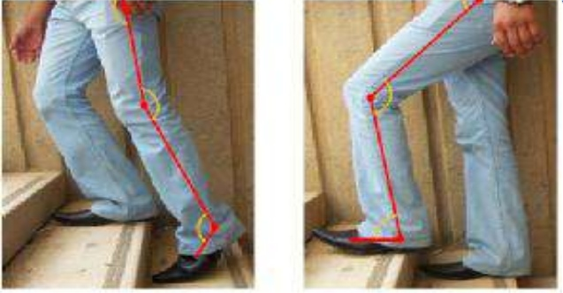
Ascending stairs
Kinetics- muscle activity
Swing phase- Foot clearance through foot Placement
Hip – Gluteus medius and maximus
Knee- Semitnedinosus, Vastus laterlais , rectus femoris
Ankle – Tibalis anterior

Slide 57
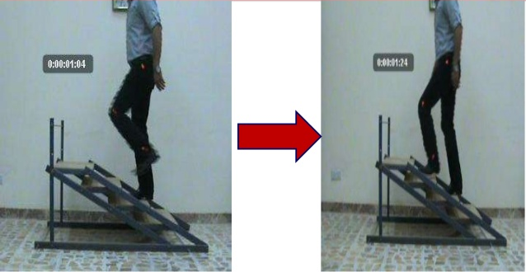
Foot clearance through foot placement
Hip – 10-20 flexion
Knee- flexion 10 degree
Ankle – Dorsiflexion 10

Slide 58
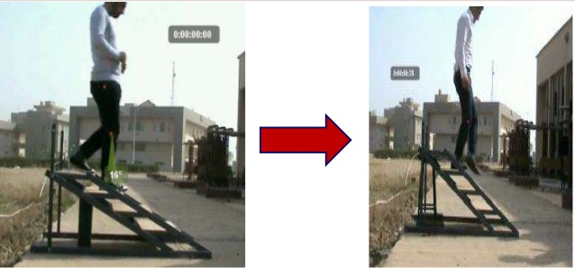
Step Descent
Weight acceptance through forward continuance
Hip – Extension 20-30
Knee – Flexion 5-10 degree of flexion
Ankle - Dorsiflexion 5-10 degree of

Slide 59
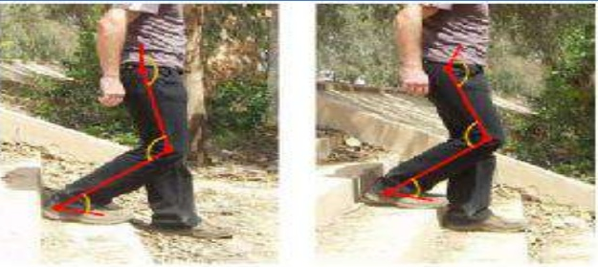
Weight acceptance through forward continuance
Hip – Gluteus maximus, gluteus medius
Knee- Vastus lateralis , rectus femoris
Ankle- Tibialis anterior , soleus gastrocnemius

Slide 60
Swing phase
Hip – iliopsoas
Knee- Semitendinosus , Semimembranosus
Ankle- Soleus , Gastrocnemius , Tibialis anterior

Slide 62
REACHING OVERHEAD AND FORWARD
To carry out many ADLs such as reaching to a high shelf to get a box, hanging up a jacket on hanger, the shoulders require a varying optimal range of motion.
Before a clinician is able to identify patients functional abilities, he must realize what requirements must be present for activities to perform adequately.

Slide 63
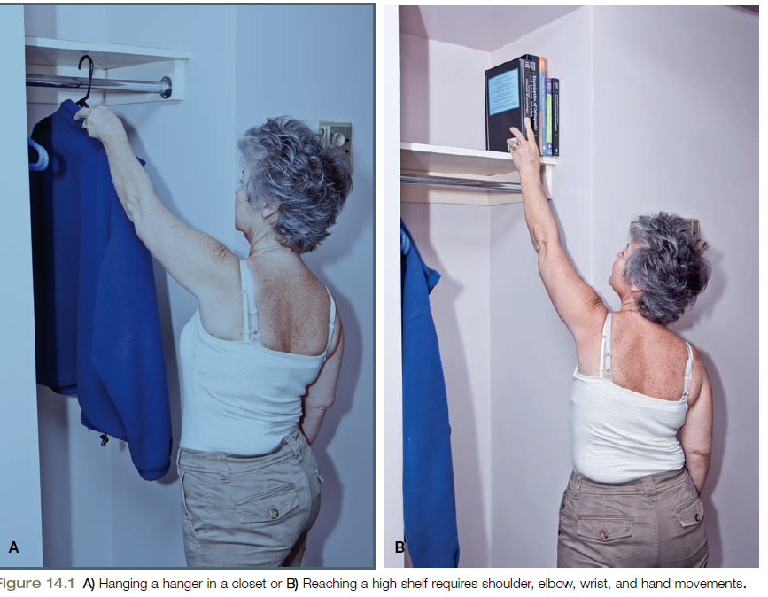

Slide 64
Reaching Overhead and Forward
Kinematics- sequence of movement
Before the shoulder moves, the trunk muscles must first prepare the body for this movement
The upper trapezius and serratus anterior then stabilize the scapula as the humerus begins elevation.
When humeral elevation begins, the rotator cuff stabilizes the humeral head in the glenoid
As the reach goes higher, the scapular muscles begin to also produce upward rotation and protraction of the scapula, and the rotator cuff muscles continue to stabilize the humeral head in the glenoid fossa

Slide 65
Reaching Overhead and Forward
Kinematics- sequence of movement
As the extremity elevates more, elbow extension progressively occurs to accurately position the hand to grasp the object.
As the hand approaches its target—the book or hanger—the fingers extend and fine tune their position (by the finger extensors) to match the size of the object.
Once the object is in the hand, the fingers flex to conform the hand to the book or hanger, and the wrist extensors synergistically fire to stabilize the wrist in slight extension.

Slide 66
Reaching Overhead and Forward
Kinematics- sequence of movement
As the object is grasped, isometric activity of the stabilizing muscles of the scapula, glenohumeral joint, elbow flexors and extensors, and wrist flexors and extensors occurs to allow the individual to pick up the object before glenohumeral muscles elevate the humerus to lift the object off the shelf or closet rod

Slide 67
Reaching Overhead and Forward
Kinematics- Joint motion
Shoulder – elevation, flexion,
Scapular upward rotation and protraction
Elbow- extension
Forarm- supination/ pronation
Wrist – Slight Extension
Fingers – flexion

Slide 68
Reaching Overhead and Forward
Kinetics – Muscle activity
Reaching – Firing of tibilais anterior first , followed by quadriceps. These muscles function as body stabilizers.
The erector spinae muscles actually begin activity after the tibialis anterior and quadriceps; this delayed activity of this muscle group occurs because the erector spinae controls trunk movement during reaching activities.
Scapular motion is performed by the trapezius and serratus anterior whereas glenohumeral motion is predominantly produced by the large movers—the clavicular head of the pectoralis major, coracobrachialis, and anterior deltoid.

Slide 69
Reaching Overhead and Forward
Kinetics – Muscle activity
Additionally, the rotator cuff works to stabilize the humeral head into the lower glenoid socket as the humerus is elevated.
As the arm begins its elevation, the triceps initially contract to extend the elbow; as the extremity moves higher, the elbow flexors take over to control the elbow.
Biceps and brachialis works eccentrically to allow the hand to grasp the object.
Wrist- cocontraction of flexos and extensors .

Slide 70
The hand assumes a spherical grasp to take the book from the shelf.
If it is hanger, the hand will assume a hook grasp.

Slide 71
Reaching overhead and Backward
Kinematics – sequence of movement
joint motion
Kinetics- Muscle activity

Slide 72
Reaching up and down to scratch your back between the scapulae is an activity that also that also requires a maximal amount of shoulder motion.
SEQUENCE OF MOVEMENT
The scapula is stabilized when shoulder activity begins.
Shoulder flexion initiates humeral elevation movement, but the movement changes to shoulder abduction before the end of elevation.
As the shoulder elevates, the shoulder laterally rotates and the elbow flexes .
Once the hand is behind the upper back, the posterior deltoid positions the hand in the right location of the back.

Slide 73
With the hand correctly positioned, the shoulder, elbow, wrist are stabilized as the fingers flex and extend to relieve the itch.
JOINT MOTION
Shoulder – flexion, lateral rotation, abduction
Scapula- Upward rotation, retraction
Elbow- flexion
Forearm- supination
Finger- flexion and extension.

Slide 74
MUSCLE ACTIVITY
Scapular upward rotation- upper and lower trapezius, serratus anterior
Scapular retraction- rhomboids, middle trapezius
Shoulder flexion- clavicular head of pectoralis major, anterior deltoid
Shoulder abduction- supraspinatus, middle deltoid
Posterior deltoid plays a role in positioning the hand behind the upper back by moving the humerus above the head.
Lateral rotation- infraspinatus, teres minor
Elbow flexion- biceps
Supination- supinator

Slide 75
Once the hand is overhead, triceps eccentrically control
Wrist- coactivation of wrist flexors and extensors to allow the finger flexors and extensors to flex and extend.

Slide 77
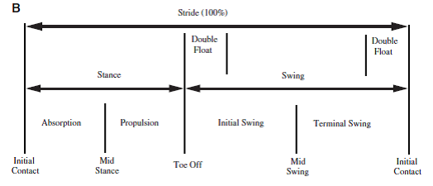
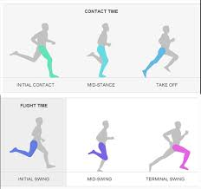
RUNNING

Slide 78
RUNNING
Kinematics – Joint Motion
Beginning of stance phase - hip is in about 50deg flexion at heel strike, continuing to extend during the rest of the stance phase. It reaches 10 deg of hyperextension after toe off.
The hip flexes to 55 deg flexion in the late swing phase.
Before the end of the swing phase, the hip extends to 50 deg to prepare for the heel strike.
The knee flexes to about 40 deg as the heel strikes, then flexes to 60deg during the loading response

Slide 79
RUNNING
Kinematics – Joint Motion
Plantar flexion reaches a maximum of 25deg in the first few seconds of of swing phase.
The ankle then dorsiflexes throughout the swing phase to 10deg in the late stage of swing phase, preparing for heel strike.
The lower limb medially rotates during the swing phase, continuing to medially rotate at heel strike.
The foot pronates at heel strike.
Lateral rotation of the lower limb stance leg begins as the swing leg passes by the stance leg in mid stance position.

Slide 80
RUNNING
Kinetics- Muscle activity
Gluteus maximus and gluteus medius are both active at the beginning of stance phase, and also at the end of swing phase.
TFL is active from the beginning of stance, and also the end of swing phase. It is also active between early and mid swing.
Adductor Magnus is active for about 25% of cycle, from late stance to early part of swing phase.
Iliopsoas activity occurs during swing phase for 35-60% of cycle.
Quadriceps works in an eccentric manner for the initial 10% of the stance phase. Its role is to control knee flexion as the knee goes through rapid flexion.

Slide 81
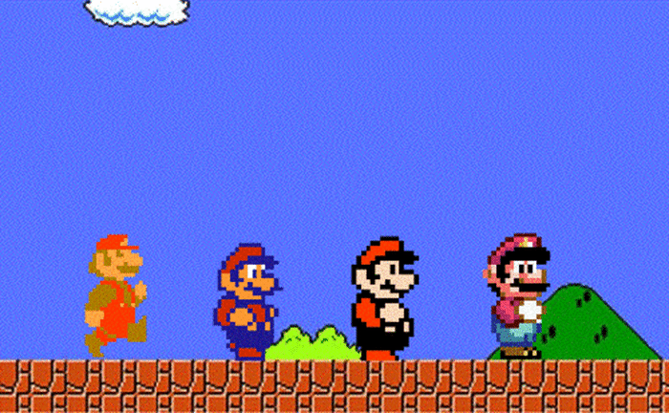
RUNNING
Kinetics- Muscle activity
Medial Hamstrings become active at the beginning of the stance phase(18-28% of stance), they are also active throughout much of the swing phase(40-58% of initial swing then the last 20% of swing). They acting to extend the hip and control the knee through concentric contraction. in late swing, the hamstrings act eccentrically to control knee extension and take the hip into extension again.

Slide 82
RUNNING
Kinetics- Muscle activity
Gastrocnemius muscle activity starts just after loading at heel strike, remaining active up until 15% of the gait cycle( this is where its activity begins in walking). It then re-starts its activity in the last 15% of the swing phase.
Tibialis anterior muscle is active through both stance and swing phases in running. It is active for about 73% of the cycle (compared to 54% when walking).
The swing phase when running, is 62% of the total gait cycle, compared to 40% when walking, so TA is considerably more active when running. Its activity is mainly concentric or isometric, enabling the foot to clear the support surface during the swing phase of the running gait.

Slide 83
PUSHING AND PULLING
The initial stage of the pull or push requires increase in isometric muscular activity of numerous muscles to overcome friction.
Whether the muscular activity is flexor or extensor will depend on whether a pull or a push is being performed and also on the posture adopted as shown in figure.
Pulling and pushing require activity of the spinal extensors and flexors, respectively.
Shoulder , elbow, wrist and hip position vary

Slide 84
PUSHING
In pushing, the first is to remove arm moments from the linkage by applying force with the upper torso directly against the load as shown in figure.
Pushing with the back against the load is preferable since the force is distributed over a large area of the back, leading to reduced pressure on any single part.
With the application of high forces from the feet, the elbow extensors and wrist flexors must work strongly, so there is considerable danger of the elbows collapsing into flexion and the wrist into extension

Slide 85
PULLING
Pulling is easier than pushing from a biomechanical viewpoint, mainly due to the difference in behavior of the arm musculature in the two activities.
Contraction of the leg and trunk muscles produces forces at the shoulder joints that must be transmitted to the cart by the arms.
With the application of high forces from the feet, the elbow extensors and wrist flexors must work strongly, so there is considerable danger of the elbows collapsing into flexion and the wrist into extension

Slide 86
PULLING
When pulling, the joints of the upper limb are automatically straightened, and both flexors and extensors can reduce stress in elbow ligaments, which can also contribute tensile force

Slide 87
Thankyou

